Slide 1
Logical Story Representations via FrameNet + Semantic Parsing
Lane Lawley and Lenhart Schubert

Slide 2
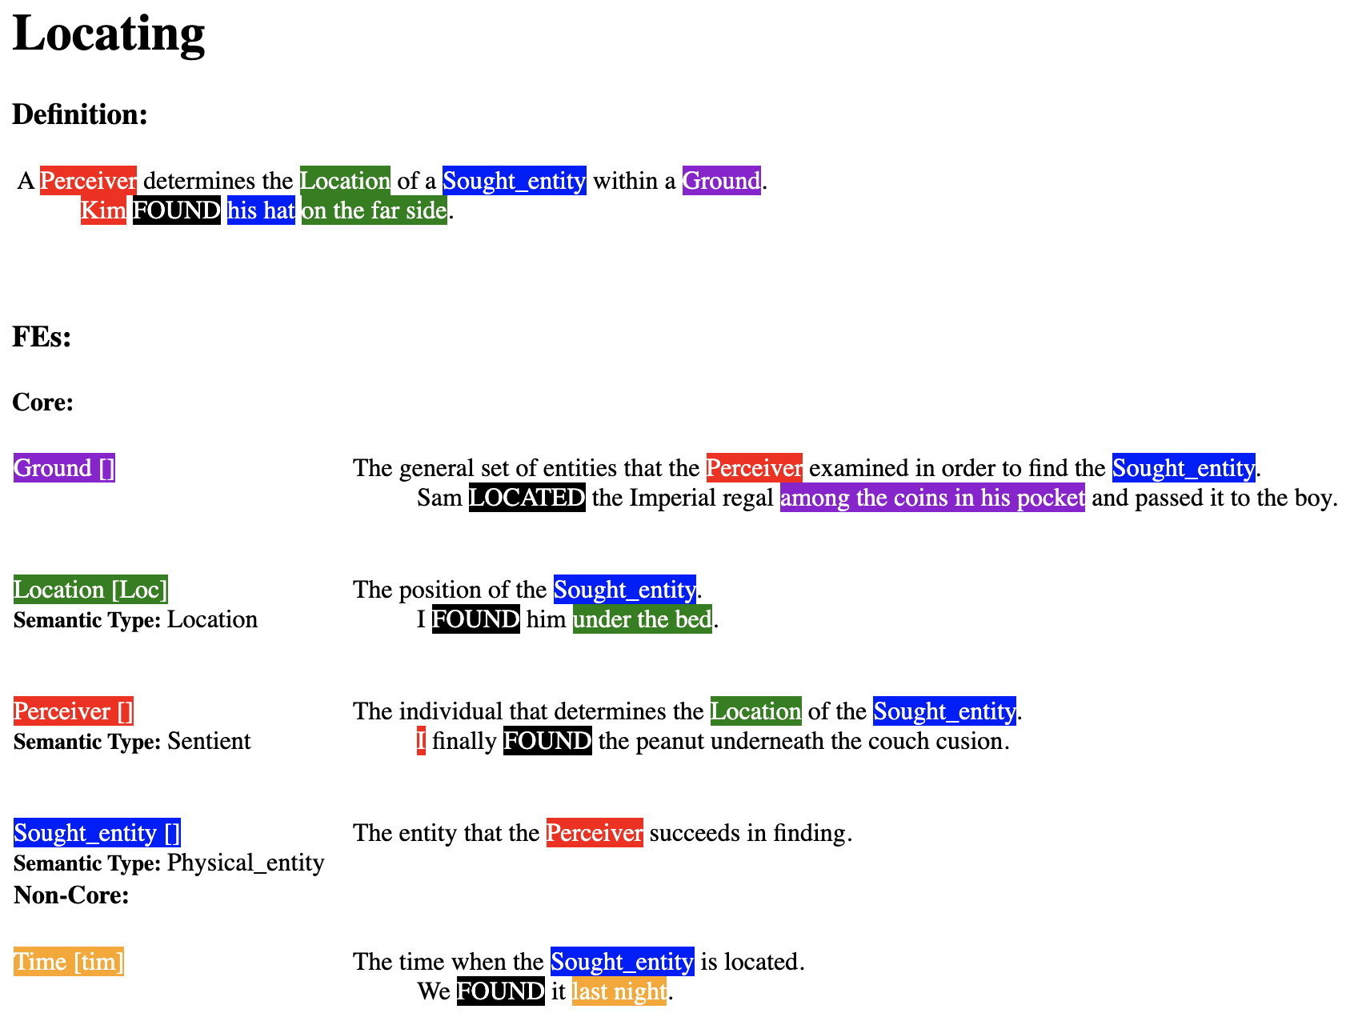
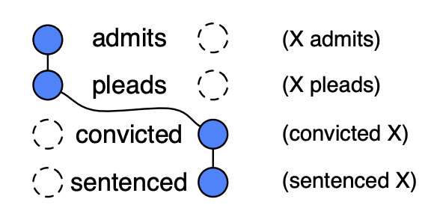
Schema/Script Representations
FrameNet:
Rich semantics (inheritance, composition)
Comprehensive semantic roles
Difficult to create new frames
Not directly usable for inference
Chambers & Jurafsky-style scripts:
Easy to acquire from large text corpora
Inexpressive event representation
Simple, linear structure

Slide 3
Episodic Logic (EL) schemas
EL schemas use a rich, formal logic designed to closely resemble English syntax.
Schemas are collections of expressive logical formulas with shared variables to aid with inference.
Gaurav looked for Mariel.
(GAURAV ((ADV-A (FOR.P MARIEL)) LOOK.V))

Slide 4
Episodic Logic (EL) schemas
EL schemas use a rich, formal logic designed to closely resemble English syntax.
Schemas are collections of expressive logical formulas with shared variables to aid with inference.
modifier
(ADV-A
(FOR.P MARIEL))
Gaurav looked for Mariel.
(GAURAV ((ADV-A (FOR.P MARIEL)) LOOK.V))
pred
LOOK.V
postfix arg 0
prefix arg
individual
GAURAV
individual
MARIEL

Slide 5
(EPI-SCHEMA ((?X GO.2.V ?L) ** ?E)
:Roles
!R1 (?B BOOK.N)
!R2 (?X PERSON.N)
!R3 (?L LIBRARY.N)
:Steps
?E1 (?X GO.V ?L)
?E2 (?X ((ADV-A (FOR.P ?B)) LOOK.V))
?E3 (?X FIND.V ?B)
?E4 (?X READ.V ?B)
:Episode-relations
!W1 (?E1 BEFORE ?E2)
!W2 (?E2 BEFORE ?E3)
!W3 (?E3 BEFORE ?E4)
:Subordinate-constraints
!S1 ((?E3-> ?Y) = ?L)
)

Slide 6
(EPI-SCHEMA ((?X GO.2.V ?L) ** ?E)
:Roles
!R1 (?B BOOK.N)
!R2 (?X PERSON.N)
!R3 (?L LIBRARY.N)
:Steps
?E1 (?X GO.V ?L)
?E2 (?X ((ADV-A (FOR.P ?B)) LOOK.V))
?E3 (?X FIND.V ?B)
?E4 (?X READ.V ?B)
:Episode-relations
!W1 (?E1 BEFORE ?E2)
!W2 (?E2 BEFORE ?E3)
!W3 (?E3 BEFORE ?E4)
:Subordinate-constraints
!S1 ((?E3-> ?Y) = ?L)
)

Slide 7
(EPI-SCHEMA ((?X GO.2.V ?L) ** ?E)
:Roles
!R1 (?B BOOK.N)
!R2 (?X PERSON.N)
!R3 (?L LIBRARY.N)
:Steps
?E1 (?X GO.V ?L)
?E2 (?X ((ADV-A (FOR.P ?B)) LOOK.V))
?E3 (?X FIND.V ?B)
?E4 (?X READ.V ?B)
:Episode-relations
!W1 (?E1 BEFORE ?E2)
!W2 (?E2 BEFORE ?E3)
!W3 (?E3 BEFORE ?E4)
:Subordinate-constraints
!S1 ((?E3-> ?Y) = ?L)
)

Slide 8
(EPI-SCHEMA ((?X GO.2.V ?L) ** ?E)
:Roles
!R1 (?B BOOK.N)
!R2 (?X PERSON.N)
!R3 (?L LIBRARY.N)
:Steps
?E1 (?X GO.V ?L)
?E2 (?X ((ADV-A (FOR.P ?B)) LOOK.V))
?E3 (?X FIND.V ?B)
?E4 (?X READ.V ?B)
:Episode-relations
!W1 (?E1 BEFORE ?E2)
!W2 (?E2 BEFORE ?E3)
!W3 (?E3 BEFORE ?E4)
:Subordinate-constraints
!S1 ((?E3-> ?Y) = ?L)
)
(EPI-SCHEMA ((?P FIND.V ?O) ** ?E)
:Roles
!R2 (?P PERSON.N)
!R3 (?O OBJECT.N)
!R3 (?Y LOCATION.N)
:Preconditions
?I1 (?O AT.P ?Y)
?I1 (?P AT.P ?Y)
?P1 (NOT (?P KNOW.V (THAT (?O AT.P ?Y))))
:Postconditions
?P1 (?P KNOW.V (THAT (?O AT.P ?Y)))
)

Slide 9
(EPI-SCHEMA ((?X GO.2.V ?L) ** ?E)
:Roles
!R1 (?B BOOK.N)
!R2 (?X PERSON.N)
!R3 (?L LIBRARY.N)
:Steps
?E1 (?X GO.V ?L)
?E2 (?X ((ADV-A (FOR.P ?B)) LOOK.V))
?E3 (?X FIND.V ?B)
?E4 (?X READ.V ?B)
:Episode-relations
!W1 (?E1 BEFORE ?E2)
!W2 (?E2 BEFORE ?E3)
!W3 (?E3 BEFORE ?E4)
:Subordinate-constraints
!S1 ((?E3-> ?Y) = ?L)
)
(EPI-SCHEMA ((?P FIND.V ?O) ** ?E)
:Roles
!R2 (?P PERSON.N)
!R3 (?O OBJECT.N)
!R3 (?Y LOCATION.N)
:Preconditions
?I1 (?O AT.P ?Y)
?I1 (?P AT.P ?Y)
?P1 (NOT (?P KNOW.V (THAT (?O AT.P ?Y))))
:Postconditions
?P1 (?P KNOW.V (THAT (?O AT.P ?Y)))
)

Slide 10
(EPI-SCHEMA ((?X GO.2.V ?L) ** ?E)
:Roles
!R1 (?B BOOK.N)
!R2 (?X PERSON.N)
!R3 (?L LIBRARY.N)
:Steps
?E1 (?X GO.V ?L)
?E2 (?X ((ADV-A (FOR.P ?B)) LOOK.V))
?E3 (?X FIND.V ?B)
?E4 (?X READ.V ?B)
:Episode-relations
!W1 (?E1 BEFORE ?E2)
!W2 (?E2 BEFORE ?E3)
!W3 (?E3 BEFORE ?E4)
:Subordinate-constraints
!S1 ((?E3-> ?Y) = ?L)
)
Bootstrap schema learning with simple “protoschemas” (e.g. FIND.V)
(EPI-SCHEMA ((?P FIND.V ?O) ** ?E)
:Roles
!R2 (?P PERSON.N)
!R3 (?O OBJECT.N)
!R3 (?Y LOCATION.N)
:Preconditions
?I1 (?O AT.P ?Y)
?I1 (?P AT.P ?Y)
?P1 (NOT (?P KNOW.V (THAT (?O AT.P ?Y))))
:Postconditions
?P1 (?P KNOW.V (THAT (?O AT.P ?Y)))
)

Slide 11
Protoschemas
Biological functions (eating, sleeping, etc.)
Self-motion
Transportation of objects
Possession
Object manipulation
Social interaction (questions, asking for favors, etc.)

Slide 12
Schema Learning
Bootstrapping with protoschemas lets us progressively build more complex schemas…

Slide 13
Schema Learning
Bootstrapping with protoschemas lets us progressively build more complex schemas…
…but how do we get the initial protoschemas from text?

Slide 14
Protoschema Invocation
(?P TRAVEL.V ?D)

Slide 15
Protoschema Invocation
(?P TRAVEL.V ?D)
He went home.

Slide 16
Protoschema Invocation
(?P TRAVEL.V ?D)
He went home.
He ran to the store.

Slide 17
Protoschema Invocation
(?P TRAVEL.V ?D)
He went home.
He ran to the store.
He was on his way.

Slide 18
Protoschema Invocation
(?P TRAVEL.V ?D)
He went home.
He ran to the store.
He was on his way.
We need a non-brittle NL-to-schema invocation identifier.

Slide 19
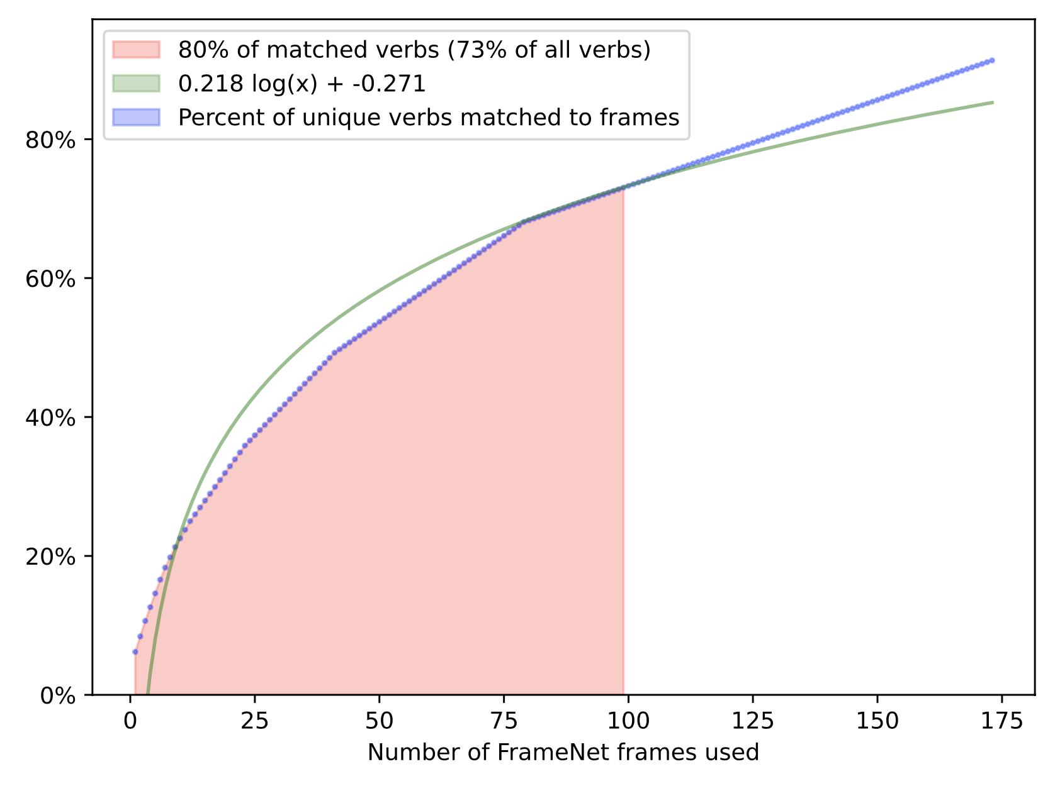
Matching Protoschemas w/ FrameNet
Like how protoschemas should cover most actions, a relatively small set of FN frames covers a relatively large number of verbs.

Slide 20
Matching Protoschemas w/ FrameNet
These most frequent FN frames inspire some basic protoschemas:
Motion
Self_motion
Experiencer_focus
Perception_experience
Arriving
Locating
Request
Bringing
Ingestion
…

Slide 21
Matching Protoschemas w/ FrameNet
These most frequent FN frames inspire some basic protoschemas:
Motion
Self_motion
Experiencer_focus
Perception_experience
Arriving
Locating
Request
Bringing
Ingestion
…

Slide 22
Matching Protoschemas w/ FrameNet
These most frequent FN frames inspire some basic protoschemas:
Motion
Self_motion
Experiencer_focus
Perception_experience
Arriving
Locating
Request
Bringing
Ingestion
…
(EPI-SCHEMA ((?P FIND.V ?O) ** ?E)
:Roles
!R2 (?P PERSON.N)
!R3 (?O OBJECT.N)
!R3 (?Y LOCATION.N)
:Preconditions
?I1 (?O AT.P ?Y)
?I1 (?P AT.P ?Y)
?P1 (NOT (?P KNOW.V (THAT (?O AT.P ?Y))))
:Postconditions
?P1 (?P KNOW.V (THAT (?O AT.P ?Y)))
)

Slide 23
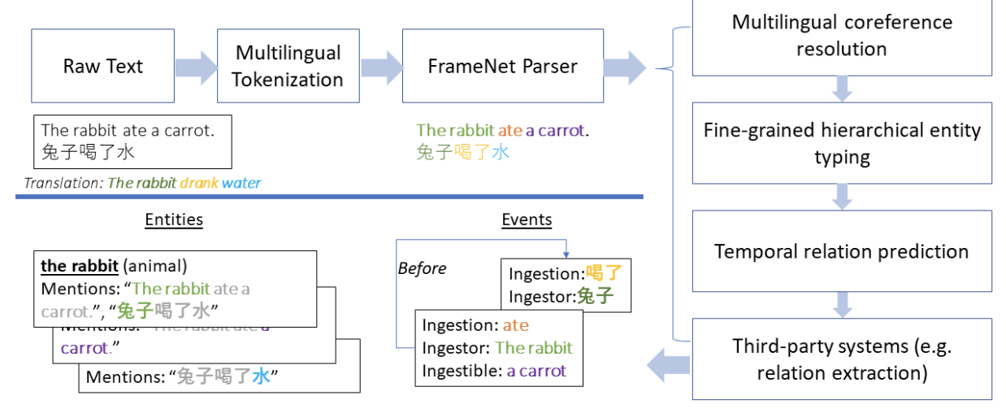
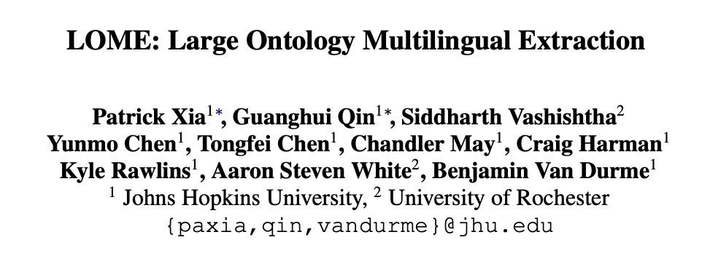
Using FrameNet parsing to match protoschemas
LOME is a state-of-the-art information extraction system with FrameNet parsing at its core.

Slide 24
Using FrameNet parsing to match protoschemas
LOME is a state-of-the-art information extraction system with FrameNet parsing at its core.

Slide 25
This Work
1. Align FN parses with EL parses, situating semantic roles in logical domain
2. Map enriched FN frames to EL protoschemas

Slide 26
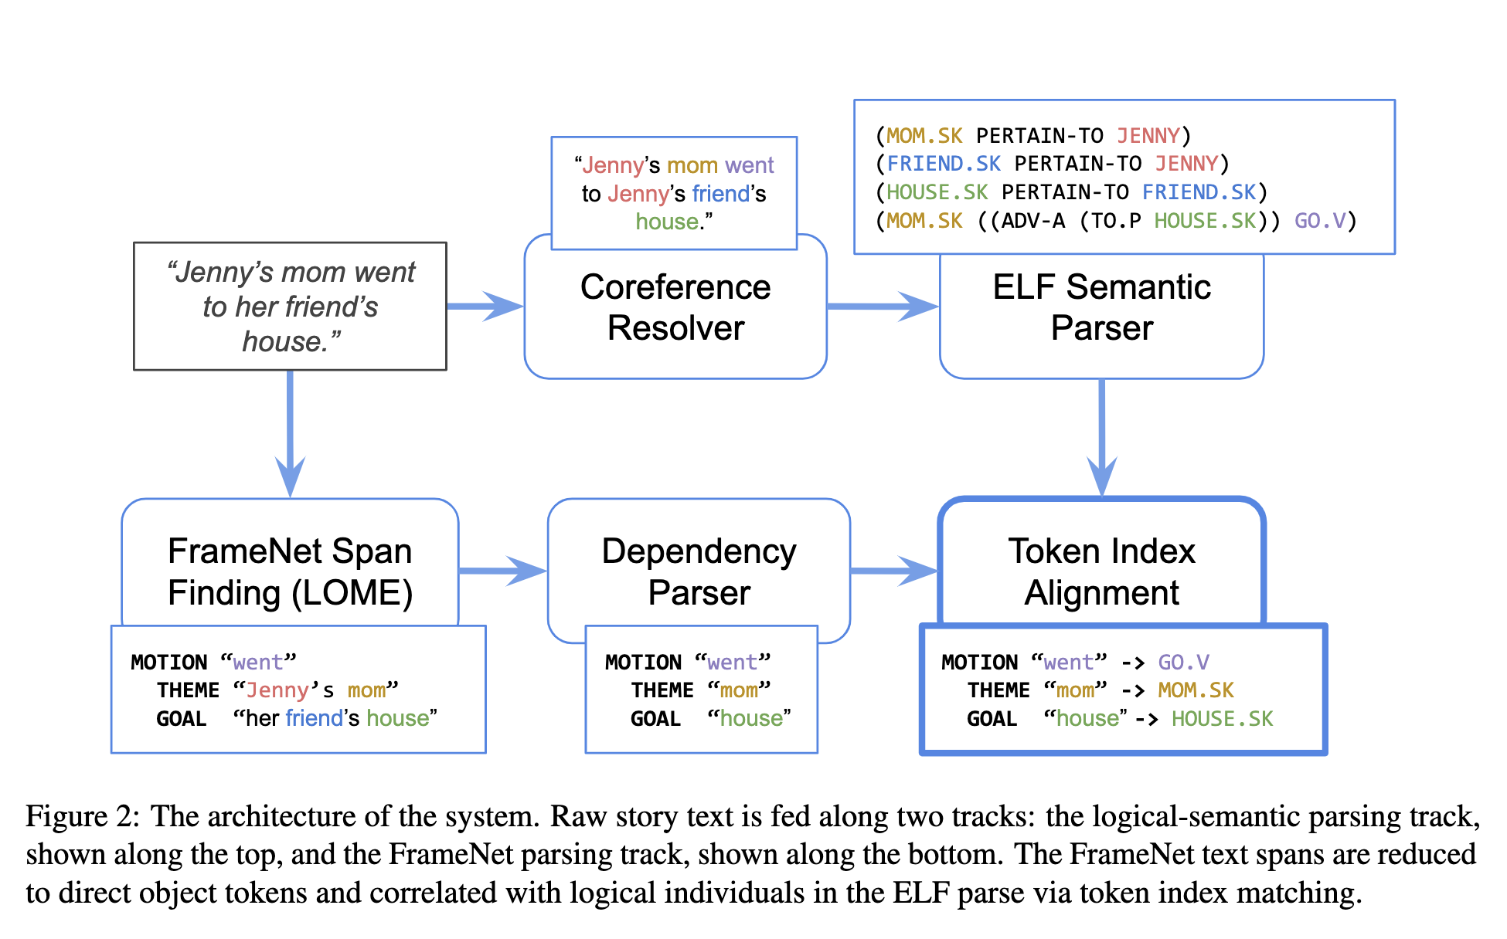
Aligning FN parses with EL parses

Slide 27
This Work: Aligning FN parses with EL parses

Slide 28
This Work: Aligning FN parses with EL parses

Slide 29
This Work: Aligning FN parses with EL parses

Slide 30
This Work: Aligning FN parses with EL parses

Slide 31
This Work: Aligning FN parses with EL parses

Slide 32
This Work: Aligning FN parses with EL parses

Slide 33
This Work: Aligning FN parses with EL parses

Slide 34
This Work: Aligning FN parses with EL parses

Slide 35
This Work: Aligning FN parses with EL parses

Slide 36
This Work: Aligning FN parses with EL parses

Slide 37
MOTION GO.V
THEME MOM.SK
GOAL HOUSE.SK

Slide 38
MOTION GO.V
THEME MOM.SK
GOAL HOUSE.SK
(MOM.SK ((ADV-A (TO.P HOUSE.SK)) GO.V)

Slide 39
MOTION GO.V
THEME MOM.SK
GOAL HOUSE.SK
(EPI-SCHEMA ((?X TRAVEL.V ?S ?D) ** ?E)
:Roles
!R1 (?X PERSON.N)
!R2 (?D LOCATION.N)
!R3 (?S LOCATION.N)
:Goals
?G1 (?X WANT.V (THAT (?X AT.P ?D)))
:Preconditions
?I1 (NOT (?X AT.P ?D))
?I2 (?X AT.P ?S)
:Postconditions
?P1 (NOT (?X AT.P ?S))
?P2 (?X AT.P ?D)
)
(MOM.SK ((ADV-A (TO.P HOUSE.SK)) GO.V)

Slide 40
MOTION GO.V
THEME MOM.SK
GOAL HOUSE.SK
(motion * -> travel.v
((?x theme)
pre-arg
(theme (if not event))
)
((?s source)
(adv from.p)
(source (if not event))
path
)
((?d goal)
(adv to.p)
(post-arg (1 of any))
(goal (if not event))
path
)
)
(EPI-SCHEMA ((?X TRAVEL.V ?S ?D) ** ?E)
:Roles
!R1 (?X PERSON.N)
!R2 (?D LOCATION.N)
!R3 (?S LOCATION.N)
:Goals
?G1 (?X WANT.V (THAT (?X AT.P ?D)))
:Preconditions
?I1 (NOT (?X AT.P ?D))
?I2 (?X AT.P ?S)
:Postconditions
?P1 (NOT (?X AT.P ?S))
?P2 (?X AT.P ?D)
)
(MOM.SK ((ADV-A (TO.P HOUSE.SK)) GO.V)

Slide 41
MOTION GO.V
THEME MOM.SK
GOAL HOUSE.SK
(motion * -> travel.v
((?x theme)
pre-arg
(theme (if not event))
)
((?s source)
(adv from.p)
(source (if not event))
path
)
((?d goal)
(adv to.p)
(post-arg (1 of any))
(goal (if not event))
path
)
)
(EPI-SCHEMA ((?X TRAVEL.V ?S ?D) ** ?E)
:Roles
!R1 (?X PERSON.N)
!R2 (?D LOCATION.N)
!R3 (?S LOCATION.N)
:Goals
?G1 (?X WANT.V (THAT (?X AT.P ?D)))
:Preconditions
?I1 (NOT (?X AT.P ?D))
?I2 (?X AT.P ?S)
:Postconditions
?P1 (NOT (?X AT.P ?S))
?P2 (?X AT.P ?D)
)
(MOM.SK ((ADV-A (TO.P HOUSE.SK)) GO.V)

Slide 42
MOTION GO.V
THEME MOM.SK
GOAL HOUSE.SK
(motion * -> travel.v
((?x theme)
pre-arg
(theme (if not event))
)
((?s source)
(adv from.p)
(source (if not event))
path
)
((?d goal)
(adv to.p)
(post-arg (1 of any))
(goal (if not event))
path
)
)
(EPI-SCHEMA ((?X TRAVEL.V ?S ?D) ** ?E)
:Roles
!R1 (?X PERSON.N)
!R2 (?D LOCATION.N)
!R3 (?S LOCATION.N)
:Goals
?G1 (?X WANT.V (THAT (?X AT.P ?D)))
:Preconditions
?I1 (NOT (?X AT.P ?D))
?I2 (?X AT.P ?S)
:Postconditions
?P1 (NOT (?X AT.P ?S))
?P2 (?X AT.P ?D)
)
(MOM.SK ((ADV-A (TO.P HOUSE.SK)) GO.V)

Slide 43
MOTION GO.V
THEME MOM.SK
GOAL HOUSE.SK
(motion * -> travel.v
((?x theme)
pre-arg
(theme (if not event))
)
((?s source)
(adv from.p)
(source (if not event))
path
)
((?d goal)
(adv to.p)
(post-arg (1 of any))
(goal (if not event))
path
)
)
(EPI-SCHEMA ((?X TRAVEL.V ?S ?D) ** ?E)
:Roles
!R1 (?X PERSON.N)
!R2 (?D LOCATION.N)
!R3 (?S LOCATION.N)
:Goals
?G1 (?X WANT.V (THAT (?X AT.P ?D)))
:Preconditions
?I1 (NOT (?X AT.P ?D))
?I2 (?X AT.P ?S)
:Postconditions
?P1 (NOT (?X AT.P ?S))
?P2 (?X AT.P ?D)
)
(MOM.SK ((ADV-A (TO.P HOUSE.SK)) GO.V)

Slide 44
MOTION GO.V
THEME MOM.SK
GOAL HOUSE.SK
(motion * -> travel.v
((?x theme)
pre-arg
(theme (if not event))
)
((?s source)
(adv from.p)
(source (if not event))
path
)
((?d goal)
(adv to.p)
(post-arg (1 of any))
(goal (if not event))
path
)
)
(EPI-SCHEMA ((?X TRAVEL.V ?S ?D) ** ?E)
:Roles
!R1 (?X PERSON.N)
!R2 (?D LOCATION.N)
!R3 (?S LOCATION.N)
:Goals
?G1 (?X WANT.V (THAT (?X AT.P ?D)))
:Preconditions
?I1 (NOT (?X AT.P ?D))
?I2 (?X AT.P ?S)
:Postconditions
?P1 (NOT (?X AT.P ?S))
?P2 (?X AT.P ?D)
)
(MOM.SK ((ADV-A (TO.P HOUSE.SK)) GO.V)

Slide 45
MOTION GO.V
THEME MOM.SK
GOAL HOUSE.SK
(motion * -> travel.v
((?x theme)
pre-arg
(theme (if not event))
)
((?s source)
(adv from.p)
(source (if not event))
path
)
((?d goal)
(adv to.p)
(post-arg (1 of any))
(goal (if not event))
path
)
)
(EPI-SCHEMA ((?X TRAVEL.V ?S ?D) ** ?E)
:Roles
!R1 (?X PERSON.N)
!R2 (?D LOCATION.N)
!R3 (?S LOCATION.N)
:Goals
?G1 (?X WANT.V (THAT (?X AT.P ?D)))
:Preconditions
?I1 (NOT (?X AT.P ?D))
?I2 (?X AT.P ?S)
:Postconditions
?P1 (NOT (?X AT.P ?S))
?P2 (?X AT.P ?D)
)
(MOM.SK ((ADV-A (TO.P HOUSE.SK)) GO.V)

Slide 46
MOTION GO.V
THEME MOM.SK
GOAL HOUSE.SK
(motion * -> travel.v
((?x theme)
pre-arg
(theme (if not event))
)
((?s source)
(adv from.p)
(source (if not event))
path
)
((?d goal)
(adv to.p)
(post-arg (1 of any))
(goal (if not event))
path
)
)
(EPI-SCHEMA ((?X TRAVEL.V ?S ?D) ** ?E)
:Roles
!R1 (?X PERSON.N)
!R2 (?D LOCATION.N)
!R3 (?S LOCATION.N)
:Goals
?G1 (?X WANT.V (THAT (?X AT.P ?D)))
:Preconditions
?I1 (NOT (?X AT.P ?D))
?I2 (?X AT.P ?S)
:Postconditions
?P1 (NOT (?X AT.P ?S))
?P2 (?X AT.P ?D)
)
(MOM.SK ((ADV-A (TO.P HOUSE.SK)) GO.V)

Slide 47
MOTION GO.V
THEME MOM.SK
GOAL HOUSE.SK
(motion * -> travel.v
((?x theme)
pre-arg
(theme (if not event))
)
((?s source)
(adv from.p)
(source (if not event))
path
)
((?d goal)
(adv to.p)
(post-arg (1 of any))
(goal (if not event))
path
)
)
(EPI-SCHEMA ((?X TRAVEL.V ?S ?D) ** ?E)
:Roles
!R1 (?X PERSON.N)
!R2 (?D LOCATION.N)
!R3 (?S LOCATION.N)
:Goals
?G1 (?X WANT.V (THAT (?X AT.P ?D)))
:Preconditions
?I1 (NOT (?X AT.P ?D))
?I2 (?X AT.P ?S)
:Postconditions
?P1 (NOT (?X AT.P ?S))
?P2 (?X AT.P ?D)
)
(MOM.SK ((ADV-A (TO.P HOUSE.SK)) GO.V)

Slide 48
MOTION GO.V
THEME MOM.SK
GOAL HOUSE.SK
(motion * -> travel.v
((?x theme)
pre-arg
(theme (if not event))
)
((?s source)
(adv from.p)
(source (if not event))
path
)
((?d goal)
(adv to.p)
(post-arg (1 of any))
(goal (if not event))
path
)
)
(EPI-SCHEMA ((?X TRAVEL.V ?S ?D) ** ?E)
:Roles
!R1 (?X PERSON.N)
!R2 (?D LOCATION.N)
!R3 (?S LOCATION.N)
:Goals
?G1 (?X WANT.V (THAT (?X AT.P ?D)))
:Preconditions
?I1 (NOT (?X AT.P ?D))
?I2 (?X AT.P ?S)
:Postconditions
?P1 (NOT (?X AT.P ?S))
?P2 (?X AT.P ?D)
)
(MOM.SK ((ADV-A (TO.P HOUSE.SK)) GO.V)

Slide 49
MOTION GO.V
THEME MOM.SK
GOAL HOUSE.SK
(motion * -> travel.v
((?x theme)
pre-arg
(theme (if not event))
)
((?s source)
(adv from.p)
(source (if not event))
path
)
((?d goal)
(adv to.p)
(post-arg (1 of any))
(goal (if not event))
path
)
)
(EPI-SCHEMA ((?X TRAVEL.V ?S ?D) ** ?E)
:Roles
!R1 (?X PERSON.N)
!R2 (?D LOCATION.N)
!R3 (?S LOCATION.N)
:Goals
?G1 (?X WANT.V (THAT (?X AT.P ?D)))
:Preconditions
?I1 (NOT (?X AT.P ?D))
?I2 (?X AT.P ?S)
:Postconditions
?P1 (NOT (?X AT.P ?S))
?P2 (?X AT.P ?D)
)
(MOM.SK ((ADV-A (TO.P HOUSE.SK)) GO.V)

Slide 50
MOTION GO.V
THEME MOM.SK
GOAL HOUSE.SK
(motion * -> travel.v
((?x theme)
pre-arg
(theme (if not event))
)
((?s source)
(adv from.p)
(source (if not event))
path
)
((?d goal)
(adv to.p)
(post-arg (1 of any))
(goal (if not event))
path
)
)
(EPI-SCHEMA ((?X TRAVEL.V ?S ?D) ** ?E)
:Roles
!R1 (MOM.SK PERSON.N)
!R2 (HOUSE.SK LOCATION.N)
!R3 (?S LOCATION.N)
:Goals
?G1 (?X WANT.V (THAT (?X AT.P ?D)))
:Preconditions
?I1 (NOT (?X AT.P ?D))
?I2 (?X AT.P ?S)
:Postconditions
?P1 (NOT (?X AT.P ?S))
?P2 (?X AT.P ?D)
)
(MOM.SK ((ADV-A (TO.P HOUSE.SK)) GO.V)

Slide 51
MOTION GO.V
THEME MOM.SK
GOAL HOUSE.SK
(motion * -> travel.v
((?x theme)
pre-arg
(theme (if not event))
)
((?s source)
(adv from.p)
(source (if not event))
path
)
((?d goal)
(adv to.p)
(post-arg (1 of any))
(goal (if not event))
path
)
)
(EPI-SCHEMA ((MOM.SK TRAVEL.V ?S HOUSE.SK) ** ?E)
:Roles
!R1 (MOM.SK PERSON.N)
!R2 (HOUSE.SK LOCATION.N)
!R3 (?S LOCATION.N)
:Goals
?G1 (MOM.SK WANT.V (THAT (MOM.SK AT.P HOUSE.SK)))
:Preconditions
?I1 (NOT (MOM.SK AT.P HOUSE.SK))
?I2 (MOM.SK AT.P ?S)
:Postconditions
?P1 (NOT (MOM.SK AT.P ?S))
?P2 (MOM.SK AT.P HOUSE.SK)
)
(MOM.SK ((ADV-A (TO.P HOUSE.SK)) GO.V)

Slide 52
(EPI-SCHEMA ((MOM.SK TRAVEL.V ?S HOUSE.SK) ** ?E)
:Roles
!R1 (MOM.SK PERSON.N)
!R2 (HOUSE.SK LOCATION.N)
!R3 (?S LOCATION.N)
:Goals
?G1 (MOM.SK WANT.V (THAT (MOM.SK AT.P HOUSE.SK)))
:Preconditions
?I1 (NOT (MOM.SK AT.P HOUSE.SK))
?I2 (MOM.SK AT.P ?S)
:Postconditions
?P1 (NOT (MOM.SK AT.P ?S))
?P2 (MOM.SK AT.P HOUSE.SK)
)

Slide 53
(MOM.SK PERTAIN-TO JENNY)
(FRIEND.SK PERTAIN-TO JENNY)
(HOUSE.SK PERTAIN-TO FRIEND.SK)
(MOM.SK ((ADV-A (TO.P HOUSE.SK)) GO.V)
(EPI-SCHEMA ((MOM.SK TRAVEL.V ?S HOUSE.SK) ** ?E)
:Roles
!R1 (MOM.SK PERSON.N)
!R2 (HOUSE.SK LOCATION.N)
!R3 (?S LOCATION.N)
:Goals
?G1 (MOM.SK WANT.V (THAT (MOM.SK AT.P HOUSE.SK)))
:Preconditions
?I1 (NOT (MOM.SK AT.P HOUSE.SK))
?I2 (MOM.SK AT.P ?S)
:Postconditions
?P1 (NOT (MOM.SK AT.P ?S))
?P2 (MOM.SK AT.P HOUSE.SK)
)

Slide 54
(MOM.SK PERTAIN-TO JENNY)
(FRIEND.SK PERTAIN-TO JENNY)
(HOUSE.SK PERTAIN-TO FRIEND.SK)
(MOM.SK ((ADV-A (TO.P HOUSE.SK)) GO.V)
(MOM.SK MOM.N)
(FRIEND.SK FRIEND.N)
(HOUSE.SK HOUSE.N)
(EPI-SCHEMA ((MOM.SK TRAVEL.V ?S HOUSE.SK) ** ?E)
:Roles
!R1 (MOM.SK PERSON.N)
!R2 (HOUSE.SK LOCATION.N)
!R3 (?S LOCATION.N)
:Goals
?G1 (MOM.SK WANT.V (THAT (MOM.SK AT.P HOUSE.SK)))
:Preconditions
?I1 (NOT (MOM.SK AT.P HOUSE.SK))
?I2 (MOM.SK AT.P ?S)
:Postconditions
?P1 (NOT (MOM.SK AT.P ?S))
?P2 (MOM.SK AT.P HOUSE.SK)
)

Slide 55
(EPI-SCHEMA ((MOM.SK TRAVEL.V ?S HOUSE.SK) ** ?E)
:Roles
!R1 (MOM.SK PERSON.N)
!R2 (HOUSE.SK LOCATION.N)
!R3 (?S LOCATION.N)
!R4 (MOM.SK MOM.N)
!R5 (HOUSE.SK HOUSE.N)
!R6 (MOM.SK PERTAIN-TO JENNY)
!R7 (HOUSE.SK PERTAIN-TO FRIEND.SK)
!R8 (FRIEND.SK FRIEND.N)
!R9 (FRIEND.SK PERTAIN-TO JENNY)
:Goals
?G1 (MOM.SK WANT.V (THAT (MOM.SK AT.P HOUSE.SK)))
:Preconditions
?I1 (NOT (MOM.SK AT.P HOUSE.SK))
?I2 (MOM.SK AT.P ?S)
:Postconditions
?P1 (NOT (MOM.SK AT.P ?S))
?P2 (MOM.SK AT.P HOUSE.SK)
)
(MOM.SK PERTAIN-TO JENNY)
(FRIEND.SK PERTAIN-TO JENNY)
(HOUSE.SK PERTAIN-TO FRIEND.SK)
(MOM.SK ((ADV-A (TO.P HOUSE.SK)) GO.V)
(MOM.SK MOM.N)
(FRIEND.SK FRIEND.N)
(HOUSE.SK HOUSE.N)

Slide 56
(EPI-SCHEMA ((MOM.SK TRAVEL.V ?S HOUSE.SK) ** ?E)
:Roles
!R1 (MOM.SK PERSON.N)
!R2 (HOUSE.SK LOCATION.N)
!R3 (?S LOCATION.N)
!R4 (MOM.SK MOM.N)
!R5 (HOUSE.SK HOUSE.N)
!R6 (MOM.SK PERTAIN-TO JENNY)
!R7 (HOUSE.SK PERTAIN-TO FRIEND.SK)
!R8 (FRIEND.SK FRIEND.N)
!R9 (FRIEND.SK PERTAIN-TO JENNY)
:Goals
?G1 (MOM.SK WANT.V (THAT (MOM.SK AT.P HOUSE.SK)))
:Preconditions
?I1 (NOT (MOM.SK AT.P HOUSE.SK))
?I2 (MOM.SK AT.P ?S)
:Postconditions
?P1 (NOT (MOM.SK AT.P ?S))
?P2 (MOM.SK AT.P HOUSE.SK)
)
(MOM.SK PERTAIN-TO JENNY)
(FRIEND.SK PERTAIN-TO JENNY)
(HOUSE.SK PERTAIN-TO FRIEND.SK)
(MOM.SK ((ADV-A (TO.P HOUSE.SK)) GO.V)
(MOM.SK MOM.N)
(FRIEND.SK FRIEND.N)
(HOUSE.SK HOUSE.N)

Slide 57
(EPI-SCHEMA ((MOM.SK TRAVEL.V ?S HOUSE.SK) ** ?E)
:Roles
!R1 (MOM.SK PERSON.N)
!R2 (HOUSE.SK LOCATION.N)
!R3 (?S LOCATION.N)
!R4 (MOM.SK MOM.N)
!R5 (HOUSE.SK HOUSE.N)
!R6 (MOM.SK PERTAIN-TO JENNY)
!R7 (HOUSE.SK PERTAIN-TO FRIEND.SK)
!R8 (FRIEND.SK FRIEND.N)
!R9 (FRIEND.SK PERTAIN-TO JENNY)
:Goals
?G1 (MOM.SK WANT.V (THAT (MOM.SK AT.P HOUSE.SK)))
:Preconditions
?I1 (NOT (MOM.SK AT.P HOUSE.SK))
?I2 (MOM.SK AT.P ?S)
:Postconditions
?P1 (NOT (MOM.SK AT.P ?S))
?P2 (MOM.SK AT.P HOUSE.SK)
)

Slide 58
(EPI-SCHEMA ((?X TRAVEL.V ?S ?D) ** ?E)
:Roles
!R1 (?X PERSON.N)
!R2 (?D LOCATION.N)
!R3 (?S LOCATION.N)
!R4 (?X MOM.N)
!R5 (?D HOUSE.N)
!R6 (?X PERTAIN-TO ?Y)
!R7 (?D PERTAIN-TO ?F)
!R8 (?F FRIEND.N)
!R9 (?F PERTAIN-TO ?Y)
:Goals
?G1 (?X WANT.V (THAT (?X AT.P ?D)))
:Preconditions
?I1 (NOT (?X AT.P ?D))
?I2 (?X AT.P ?S)
:Postconditions
?P1 (NOT (?X AT.P ?S))
?P2 (?X AT.P ?D)
)

Slide 59
(EPI-SCHEMA ((?X TRAVEL.V ?S ?D) ** ?E)
:Roles
!R1 (?X PERSON.N)
!R2 (?D LOCATION.N)
!R3 (?S LOCATION.N)
!R4 (?X MOM.N)
!R5 (?D HOUSE.N)
!R6 (?X PERTAIN-TO ?Y)
!R7 (?D PERTAIN-TO ?F)
!R8 (?F FRIEND.N)
!R9 (?F PERTAIN-TO ?Y)
:Goals
?G1 (?X WANT.V (THAT (?X AT.P ?D)))
:Preconditions
?I1 (NOT (?X AT.P ?D))
?I2 (?X AT.P ?S)
:Postconditions
?P1 (NOT (?X AT.P ?S))
?P2 (?X AT.P ?D)
)
“Jenny’s mom went to Jenny’s friend’s house.”

Slide 60
(EPI-SCHEMA ((?X TRAVEL.V ?S ?D) ** ?E)
:Roles
!R1 (?X PERSON.N)
!R2 (?D LOCATION.N)
!R3 (?S LOCATION.N)
!R4 (?X MOM.N)
!R5 (?D HOUSE.N)
!R6 (?X PERTAIN-TO ?Y)
!R7 (?D PERTAIN-TO ?F)
!R8 (?F FRIEND.N)
!R9 (?F PERTAIN-TO ?Y)
:Goals
?G1 (?X WANT.V (THAT (?X AT.P ?D)))
:Preconditions
?I1 (NOT (?X AT.P ?D))
?I2 (?X AT.P ?S)
:Postconditions
?P1 (NOT (?X AT.P ?S))
?P2 (?X AT.P ?D)
)
“Jenny’s mom went to Jenny’s friend’s house.”
LOME
MOTION “went”
THEME “Jenny’s mom”
GOAL “her friend’s house”
Protoschema mapping
EL alignment
MOTION GO.V
THEME MOM.SK
GOAL HOUSE.SK

Slide 61
(EPI-SCHEMA ((?X TRAVEL.V ?S ?D) ** ?E)
:Roles
!R1 (?X PERSON.N)
!R2 (?D LOCATION.N)
!R3 (?S LOCATION.N)
!R4 (?X MOM.N)
!R5 (?D HOUSE.N)
!R6 (?X PERTAIN-TO ?Y)
!R7 (?D PERTAIN-TO ?F)
!R8 (?F FRIEND.N)
!R9 (?F PERTAIN-TO ?Y)
:Goals
?G1 (?X WANT.V (THAT (?X AT.P ?D)))
:Preconditions
?I1 (NOT (?X AT.P ?D))
?I2 (?X AT.P ?S)
:Postconditions
?P1 (NOT (?X AT.P ?S))
?P2 (?X AT.P ?D)
)
“Jenny’s mom went to Jenny’s friend’s house.”

Slide 62
(EPI-SCHEMA ((?X TRAVEL.V ?S ?D) ** ?E)
:Roles
!R1 (?X PERSON.N)
!R2 (?D LOCATION.N)
!R3 (?S LOCATION.N)
!R4 (?X MOM.N)
!R5 (?D HOUSE.N)
!R6 (?X PERTAIN-TO ?Y)
!R7 (?D PERTAIN-TO ?F)
!R8 (?F FRIEND.N)
!R9 (?F PERTAIN-TO ?Y)
:Goals
?G1 (?X WANT.V (THAT (?X AT.P ?D)))
:Preconditions
?I1 (NOT (?X AT.P ?D))
?I2 (?X AT.P ?S)
:Postconditions
?P1 (NOT (?X AT.P ?S))
?P2 (?X AT.P ?D)
)
“Jenny’s mom went to Jenny’s friend’s house.”

Slide 63
(EPI-SCHEMA ((?X TRAVEL.V ?S ?D) ** ?E)
:Roles
!R1 (?X PERSON.N)
!R2 (?D LOCATION.N)
!R3 (?S LOCATION.N)
!R4 (?X MOM.N)
!R5 (?D HOUSE.N)
!R6 (?X PERTAIN-TO ?Y)
!R7 (?D PERTAIN-TO ?F)
!R8 (?F FRIEND.N)
!R9 (?F PERTAIN-TO ?Y)
:Goals
?G1 (?X WANT.V (THAT (?X AT.P ?D)))
:Preconditions
?I1 (NOT (?X AT.P ?D))
?I2 (?X AT.P ?S)
:Postconditions
?P1 (NOT (?X AT.P ?S))
?P2 (?X AT.P ?D)
)
“Jenny’s mom went to Jenny’s friend’s house.”

Slide 64
(EPI-SCHEMA ((?X TRAVEL.V ?S ?D) ** ?E)
:Roles
!R1 (?X PERSON.N)
!R2 (?D LOCATION.N)
!R3 (?S LOCATION.N)
!R4 (?X MOM.N)
!R5 (?D HOUSE.N)
!R6 (?X PERTAIN-TO ?Y)
!R7 (?D PERTAIN-TO ?F)
!R8 (?F FRIEND.N)
!R9 (?F PERTAIN-TO ?Y)
:Goals
?G1 (?X WANT.V (THAT (?X AT.P ?D)))
:Preconditions
?I1 (NOT (?X AT.P ?D))
?I2 (?X AT.P ?S)
:Postconditions
?P1 (NOT (?X AT.P ?S))
?P2 (?X AT.P ?D)
)
“Jenny’s mom went to Jenny’s friend’s house.”
“Maria went to Jeff’s friend’s house.”

Slide 65
(EPI-SCHEMA ((?X TRAVEL.V ?S ?D) ** ?E)
:Roles
!R1 (?X PERSON.N)
!R2 (?D LOCATION.N)
!R3 (?S LOCATION.N)
!R4 (?X MOM.N)
!R5 (?D HOUSE.N)
!R6 (?X PERTAIN-TO ?Y)
!R7 (?D PERTAIN-TO ?F)
!R8 (?F FRIEND.N)
!R9 (?F PERTAIN-TO ?Y)
:Goals
?G1 (?X WANT.V (THAT (?X AT.P ?D)))
:Preconditions
?I1 (NOT (?X AT.P ?D))
?I2 (?X AT.P ?S)
:Postconditions
?P1 (NOT (?X AT.P ?S))
?P2 (?X AT.P ?D)
)
“Jenny’s mom went to Jenny’s friend’s house.”
“Maria went to Jeff’s friend’s house.”

Slide 66
(EPI-SCHEMA ((MARIA TRAVEL.V ?S ?D) ** ?E)
:Roles
!R1 (MARIA PERSON.N)
!R2 (?D LOCATION.N)
!R3 (?S LOCATION.N)
!R4 (MARIA MOM.N)
!R5 (?D HOUSE.N)
!R6 (MARIA PERTAIN-TO JEFF)
!R7 (?D PERTAIN-TO ?F)
!R8 (?F FRIEND.N)
!R9 (?F PERTAIN-TO JEFF)
:Goals
?G1 (MARIA WANT.V (THAT (MARIA AT.P ?D)))
:Preconditions
?I1 (NOT (MARIA AT.P ?D))
?I2 (MARIA AT.P ?S)
:Postconditions
?P1 (NOT (MARIA AT.P ?S))
?P2 (MARIA AT.P ?D)
)
“Jenny’s mom went to Jenny’s friend’s house.”
“Maria went to Jeff’s friend’s house.”

Slide 67
(EPI-SCHEMA ((MARIA TRAVEL.V ?S ?D) ** ?E)
:Roles
!R1 (MARIA PERSON.N)
!R2 (?D LOCATION.N)
!R3 (?S LOCATION.N)
!R4 (MARIA MOM.N)
!R5 (?D HOUSE.N)
!R6 (MARIA PERTAIN-TO JEFF)
!R7 (?D PERTAIN-TO ?F)
!R8 (?F FRIEND.N)
!R9 (?F PERTAIN-TO JEFF)
:Goals
?G1 (MARIA WANT.V (THAT (MARIA AT.P ?D)))
:Preconditions
?I1 (NOT (MARIA AT.P ?D))
?I2 (MARIA AT.P ?S)
:Postconditions
?P1 (NOT (MARIA AT.P ?S))
?P2 (MARIA AT.P ?D)
)
“Jenny’s mom went to Jenny’s friend’s house.”
“Maria went to Jeff’s friend’s house.”

Slide 68

Info on Wider Schema Learning Project
Mining Logical Event Schemas From Pre-Trained Language Models
Lane Lawley, Lenhart Schubert
https://aclanthology.org/2022.acl-srw.25/

Slide 69
Thank you!

